Slide 1
4739 CAD Guide

Slide 2
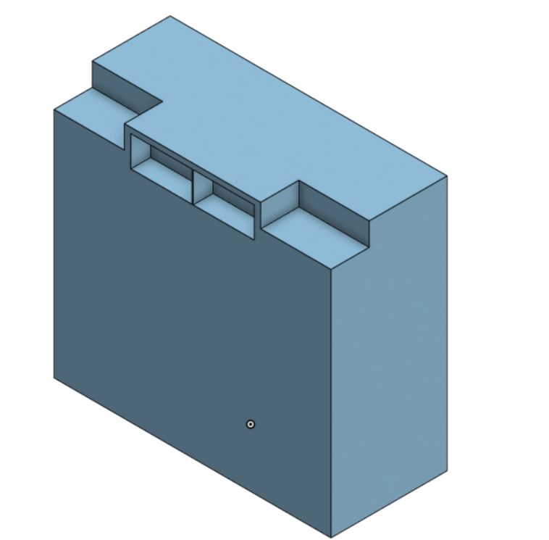
Exercise 1
Use subtractive manufacturing
First extrude, then sketch and remove
For parts such as these, we will not usually ever have to model them as we can import them with MKCad.

Slide 3
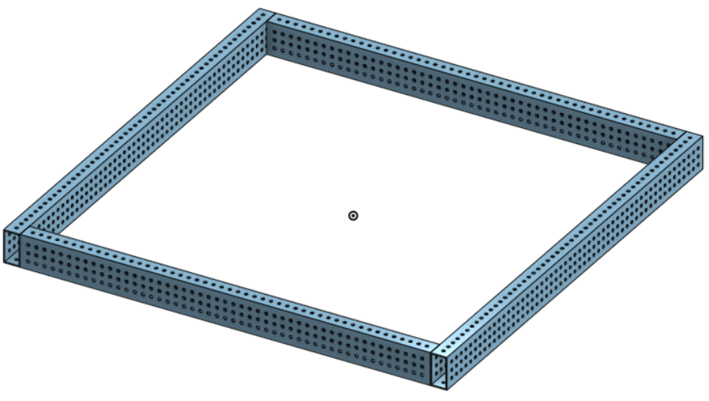
Exercise 2.1
First sketch and extrude the tubes, then add the holes (5 mm)
Now, the “proper” way to accomplish this is by using the linear and circular pattern tool, but we have a way to cheat (shhhh)
Smooth slide into featurescripts

Slide 4
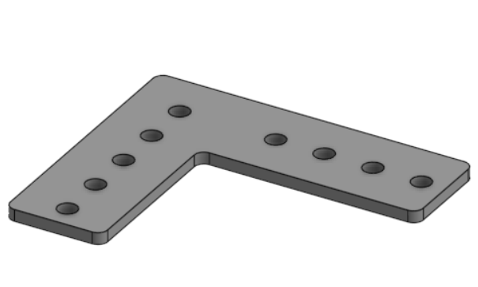

Exercise 2.2
Not suggested to make a new part studio to make parts that should be connected to other parts.
Sketch on the surface of the tubes and use the “use" tool to copy the holes.
Fillets are recommended to be 2.5 mm.

Slide 5
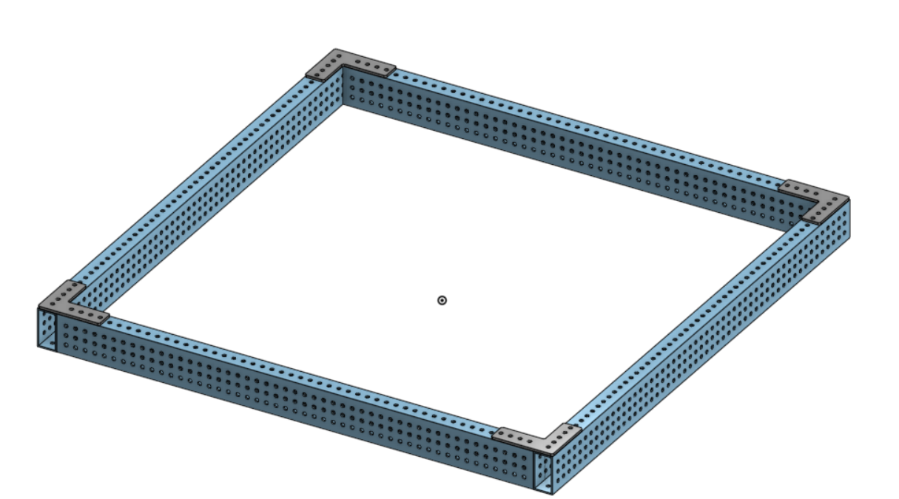
Exercise 2.3
Import the whole part studio and group it.
Copy the gusset, flip it, and fasten mate it around one hole to the drivebase.
Should be connected on both sides.
Move the assembly, does anything come undone?

Slide 6
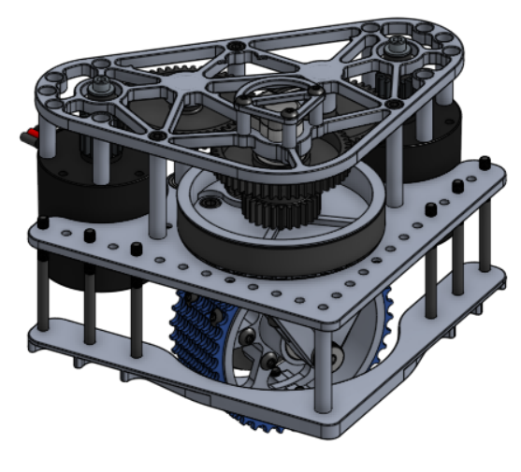
Exercise 3.1
Import the swerve modules from MKCad
Hopefully you were all okay with this one.

Slide 7
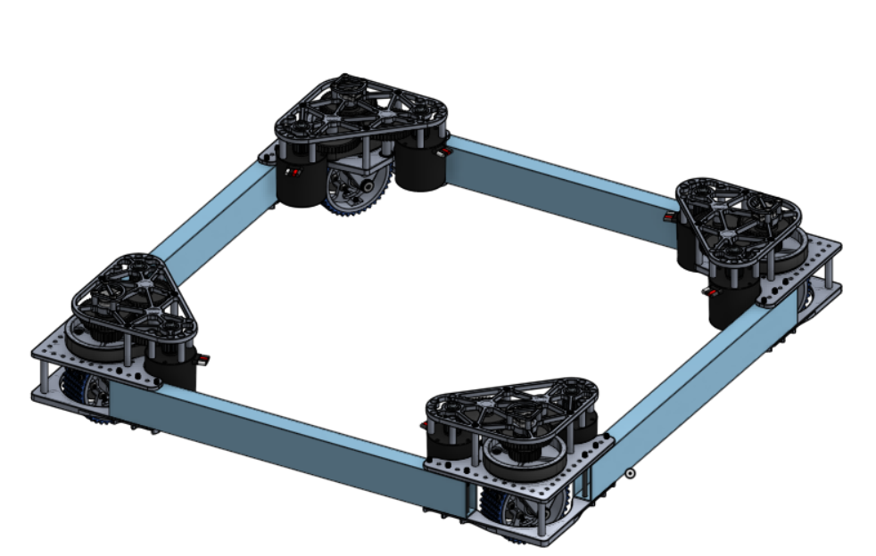
Exercise 3.2
This one is probably the most tricky one yet as you needed to find the dimensions, but hopefully that was all good.
Sketch and extrude the tube, measure out the holes and use the hole tool to punch through the tubing. (#10-32)
Copy and mate the tubes to the swerve modules.

Slide 8
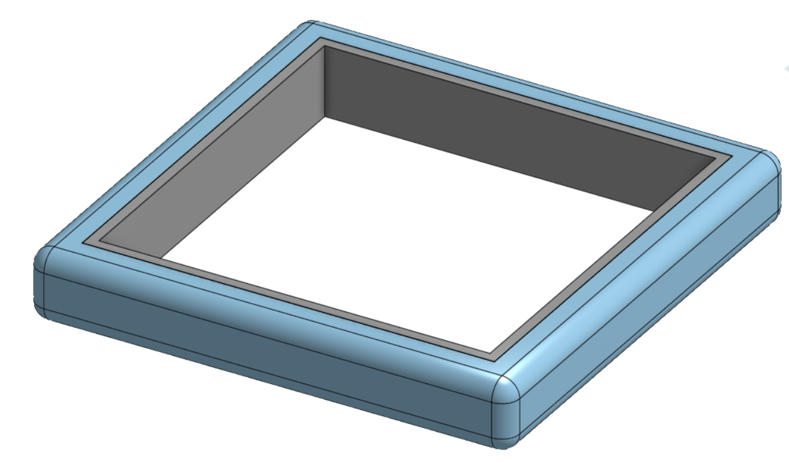
Exercise 3.2
Hopefully you figured out how to take the context of something and sketch with it.
Sketch the cross-section of the bumpers, with the bumper and backing able to be separately extruded.
Draw a line around the drivebase.
Sweep the cross-sections around the drivebase line.

